Slide 1
Theory of Computing SE-312
Lecture-2

Slide 2
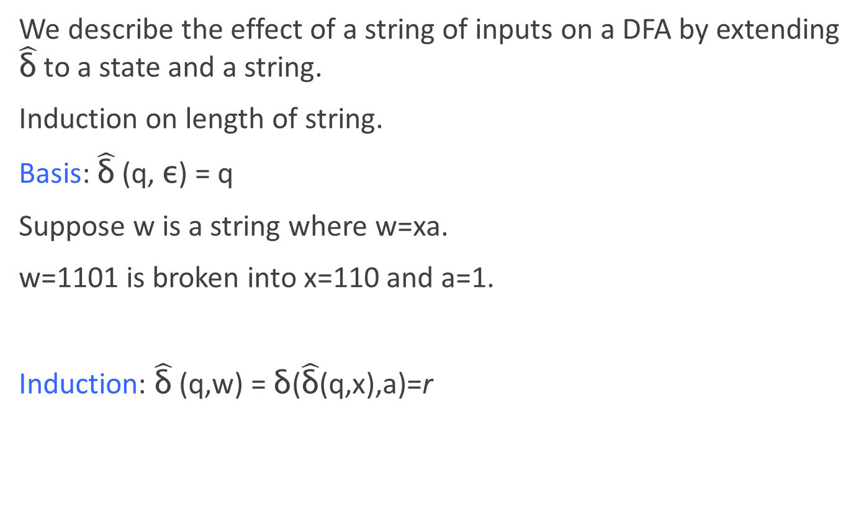
Extended Transition Function
We describe the effect of a string of inputs on a DFA by extending $\hat{\text{δ}}$to a state and a string.
Induction on length of string.
Basis: $\hat{\text{δ}}$(q, ε) = q
Suppose w is a string where w=xa.
w=1101 is broken into x=110 and a=1.
Induction: $\hat{\text{δ}}$(q,w) = δ($\hat{\text{δ}}$(q,x),a)=r

Slide 3
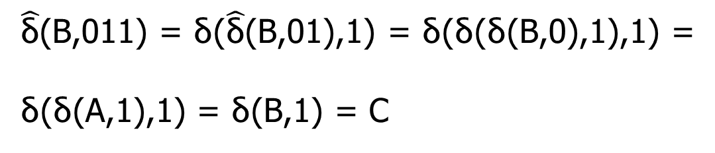
Extended Transition Function..
0
1
A A B
B A C
C C C
$\hat{\text{δ}}$(B,011) = δ($\hat{\text{δ}}$(B,01),1) = δ(δ(δ(B,0),1),1) =
δ(δ(A,1),1) = δ(B,1) = C

Slide 4
NFA
A nondeterministic finite automaton has the ability to be in several states at once.
Transitions from a state on an input symbol can be to any set of states.
This NFA accepts only those strings that end in 01
Running in “parallel threads” for string 1100101

Slide 5
Language of an NFA
An NFA accepts w if there exists at least one path from the start state to an accepting (or final) state that is labeled by w
L(N) = { w | δ(q₀,w) ∩ F ≠ Φ }

Slide 6

Extended transition function for NFA
Basis:$\hat{\text{δ}}$ (q,ε) = {q}
Induction:Suppose w is a string where w=xa.
Let $\hat{\text{δ}}$(q,x) = {p₁, p₂…,p_{k}}
$\bigcup_{i=1}^{k}{\text{δ}\text{(}\text{p}\text{i}\text{,} \text{a}\text{)}}$={r₁, r₂, r₃,…,r_{m}}
$\hat{\text{δ}}$(q, w) ={r₁, r₂, r₃,…r_{m}}

Slide 7
NFA to DFA by Subset Construction
Given N = {Q_{N},∑,δ_{N},q₀,F_{N}}
Goal: Build D={Q_{D},∑,δ_{D},{q₀},F_{D}} s.t. L(D)=L(N)
Construction:
Q_{D}= all subsets of Q_{N} (i.e., power set)
F_{D}=set of subsets S of Q_{N} s.t. S∩F_{N}≠Φ
δ_{D}: for each subset S of Q_{N} and for each input symbol a in ∑:
δ_{D}(S,a) = U δ_{N}(p,a)
p in s

Slide 8
NFA to DFA construction: Example
Idea: To avoid enumerating all of power set, do “lazy creation of states”
L = {w | w ends in 01}
1
0
[q₀]
0
[q₀,q₁]
1
[q₀,q₂]
NFA:
DFA:
0
0,1
1
δ_{D} | 0 | 1
Ø | Ø | Ø
{q₀} | {q₀,q₁} | {q₀}
{q₁} | Ø | {q₂}
*{q₂} | Ø | Ø
{q₀,q₁} | {q₀,q₁} | {q₀,q₂}
*{q₀,q₂} | {q₀,q₁} | {q₀}
*{q₁,q₂} | Ø | {q₂}
*{q₀,q₁,q₂} | {q₀,q₁} | {q₀,q₂}
δ_{D} | 0 | 1
{q₀} | {q₀,q₁} | {q₀}
{q₀,q₁} | {q₀,q₁} | {q₀,q₂}
*{q₀,q₂} | {q₀,q₁} | {q₀}
0
1
q₀
q₁
q₂
δ_{N} | 0 | 1
q₀ | {q₀,q₁} | {q₀}
q₁ | Ø | {q₂}
*q₂ | Ø | Ø
0. Enumerate all possible subsets
Determine transitions
2. Retain only those states reachable from {q₀}

Slide 9
NFA to DFA: Repeating the example using LAZY CREATION
L = {w | w ends in 01}
1
0
[q₀]
0
[q₀,q₁]
1
[q₀,q₂]
NFA:
0
DFA:
1
0,1
0
1
q₀
q₁
q₂
δ_{D} | 0 | 1
[q₀] | [q₀,q₁] | [q₀]
[q₀,q₁] | [q₀,q₁] | [q₀,q₂]
*[q₀,q₂] | [q₀,q₁] | [q₀]
δ_{N} | 0 | 1
q₀ | {q₀,q₁} | {q₀}
q₁ | Ø | {q₂}
*q₂ | Ø | Ø
Main Idea:
Introduce states as you go
(on a need basis)

Slide 10
FA with ε-Transitions
We can allow explicit ε-transitions in finite automata
i.e., a transition from one state to another state without consuming any additional input symbol
Explicit ε-transitions between different states introduce non-determinism.
Makes it easier sometimes to construct NFAs
This means that a transition is allowed to occur without reading in a symbol.
Definition: ε -NFAs are those NFAs with at least one explicit ε-transition defined.
ε -NFAs have one more column in their transition table
Transition function δ is now a function that takes as arguments:
A state in Q and
A member of ∑ ∪ {ε}; that is, an input symbol or the symbol ε. We require that ε not be a symbol of the alphabet ∑ to avoid any confusion.

Slide 11
ε-Transitions
Use of e-transitions
We allow the automaton to accept the empty string e.
This means that a transition is allowed to occur without reading in a symbol.
The resulting NFA is called e-NFA.
It adds “programming (design) convenience” (more intuitive for use in designing FA’s)

Slide 12
Example # 1: ε-NFA
Example: Draw a ε-NFA that accepts decimal numbers consisting of
1. An optional + or – sign
2. A string of digits
3. A decimal point, and
4. Another string of digits. Either this string of digits or the string (2) can be empty, but at least one of the two strings of digit must be nonempty.
0, 1, …, 9
0, 1, …, 9
.
ε, + , -
0, 1, …, 9
q₃
ε
start
q₀
q₁
q₂
q₅
0, 1, …, 9
.
q₄
an ε-NFA accepting decimal numbers
like 2.15, .125, +1.4, -0.501, +32., …

Slide 13
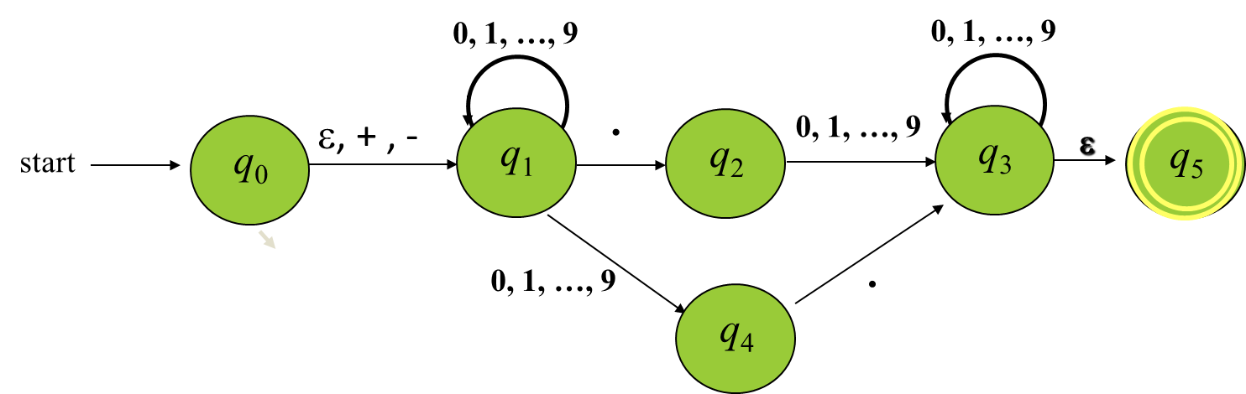
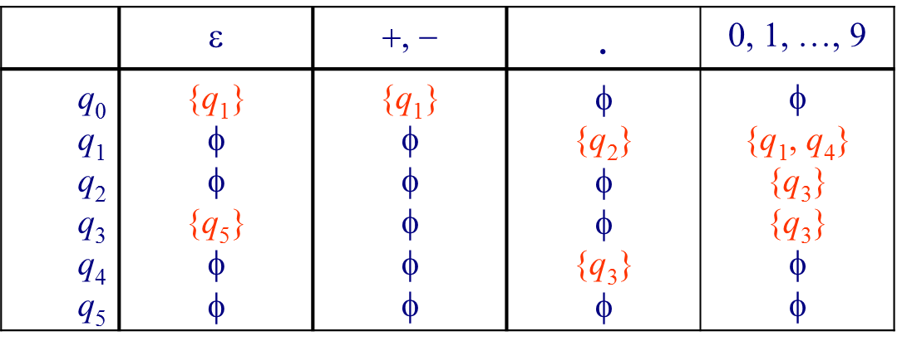
Formal Notation for an ε-NFA
Formal Notation for an e-NFA
E = ({q0, q1, ..., q5}, {., -,+, ε, 0, 1, ..., 9}, δ, q0, {q5})
The transitions, e.g., include
δ (q₀, ε) = {q1}
δ(q₁, ε) = Ø

Slide 14
Example #2: ε-NFA..
L = {w | w is empty, or if non-empty will end in 01}
0,1
ε-closure of a state q, ECLOSE(q), is the set of all states (including itself) that can be reached from q by repeatedly making an arbitrary number of ε-transitions.
q₀
0
q₁
1
q₂
ε
start
q’₀
δ_{E} | 0 | 1 | ε-closure
*q’₀ | Ø | Ø | {q’₀,q₀}
q₀ | {q₀,q₁} | {q₀} | {q₀}
q₁ | Ø | {q₂} | {q₁}
*q₂ | Ø | Ø | {q₂}
ECLOSE(q’₀)
ECLOSE(q₀)
ECLOSE(q₁)
ECLOSE(q₂)

Slide 15
Epsilon-Closures
We ε-close a state q by following all transitions out of q that are labeled ε.
Basis: state q is in ECLOSE(q).
Induction: If p is in state ECLOSE(q) and there is a transition form p to r using ε, then r is in ECLOSE(q).
ECLOSE(q₀)={q₀ , q₁}
ECLOSE(q₃)={q₃ , q₅}
0,1..,9
0,1..,9
q₀
ε,+,-
q₁
.
q₂
q₃
ε
q₅
q₅
0,1..,9
0,1..,9
.
q₄

Slide 16
Epsilon-Closures
2
ε
3
ε
6
ε
1
b
ε
4
5
7
a
ε
ECLOSE(1)
={1,2,3,4,6}
ECLOSE(2)
={2,3,6}

Slide 17
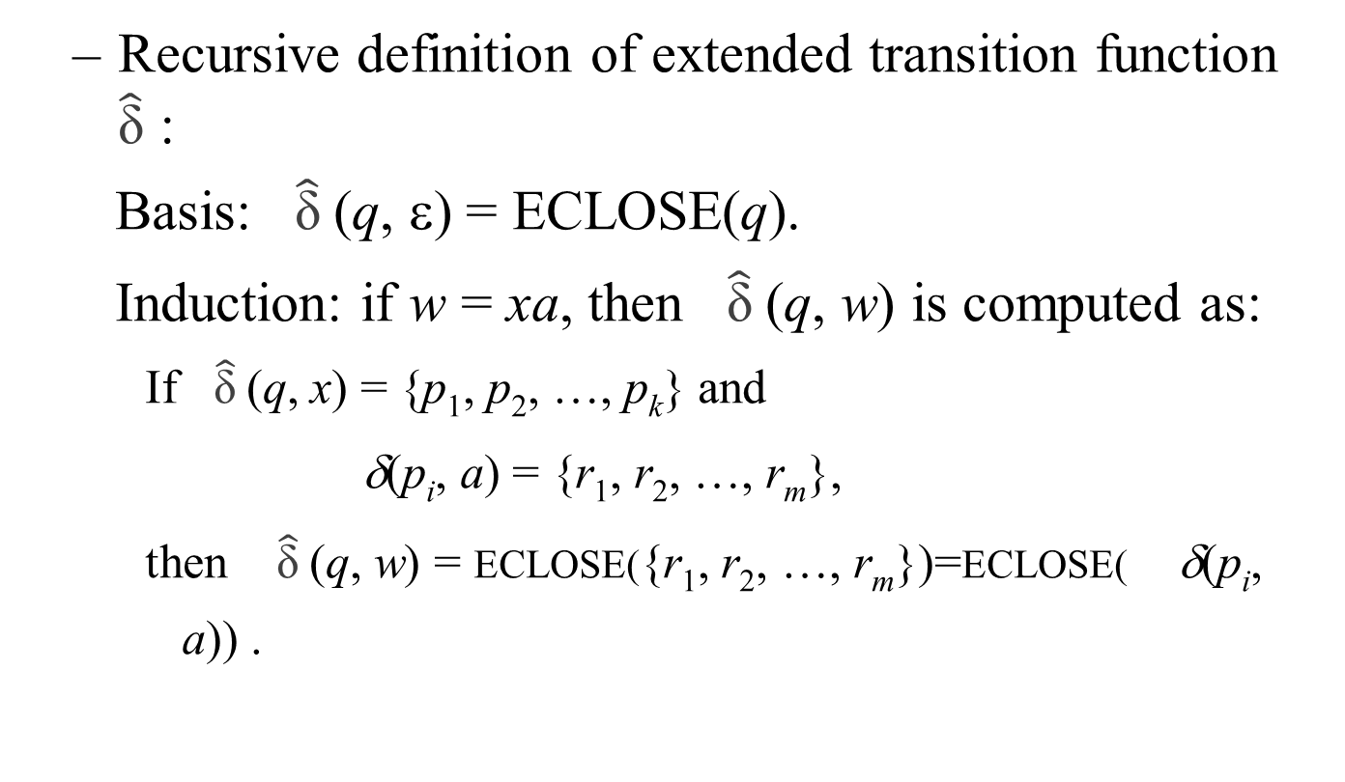
Extended Transitions & Languages for ε-NFA’s
Recursive definition of extended transition function $\hat{\text{δ}}$ :
Basis: $\hat{\text{δ}}$(q, ε) = ECLOSE(q).
Induction: if w = xa, then $\hat{\text{δ}}$(q, w) is computed as:
If $\hat{\text{δ}}$(q, x) = {p₁, p₂, …, p_{k}} and
δ(p_{i}, a) = {r₁, r₂, …, r_{m}},
then $\hat{\text{δ}}$(q, w) = ECLOSE({r₁, r₂, …, r_{m}})=ECLOSE( δ(p_{i}, a)) .

Slide 18
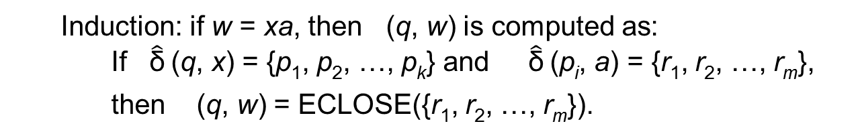

Extended Transitions & Languages for ε-NFA’s..
Induction: if w = xa, then (q, w) is computed as:
If $\hat{\text{δ}}$(q, x) = {p₁, p₂, …, p_{k}} and $\hat{\text{δ}}$(p_{i}, a) = {r₁, r₂, …, r_{m}},
then (q, w) = ECLOSE({r₁, r₂, …, r_{m}}).
$$\hat{\text{δ}}$$
(q, x)=
{ p₁
p₂
.
.
.
p_{k}}
{ r₁
r₂
.
.
.
r_{m}}
ε ...
a
ε ...
ECLOSE
{ r₁,
r₂, …,
r_{m}}
x
a
…
a
ε ...
δ

Slide 19
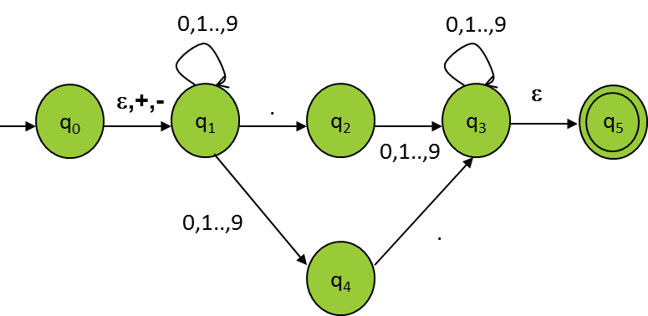
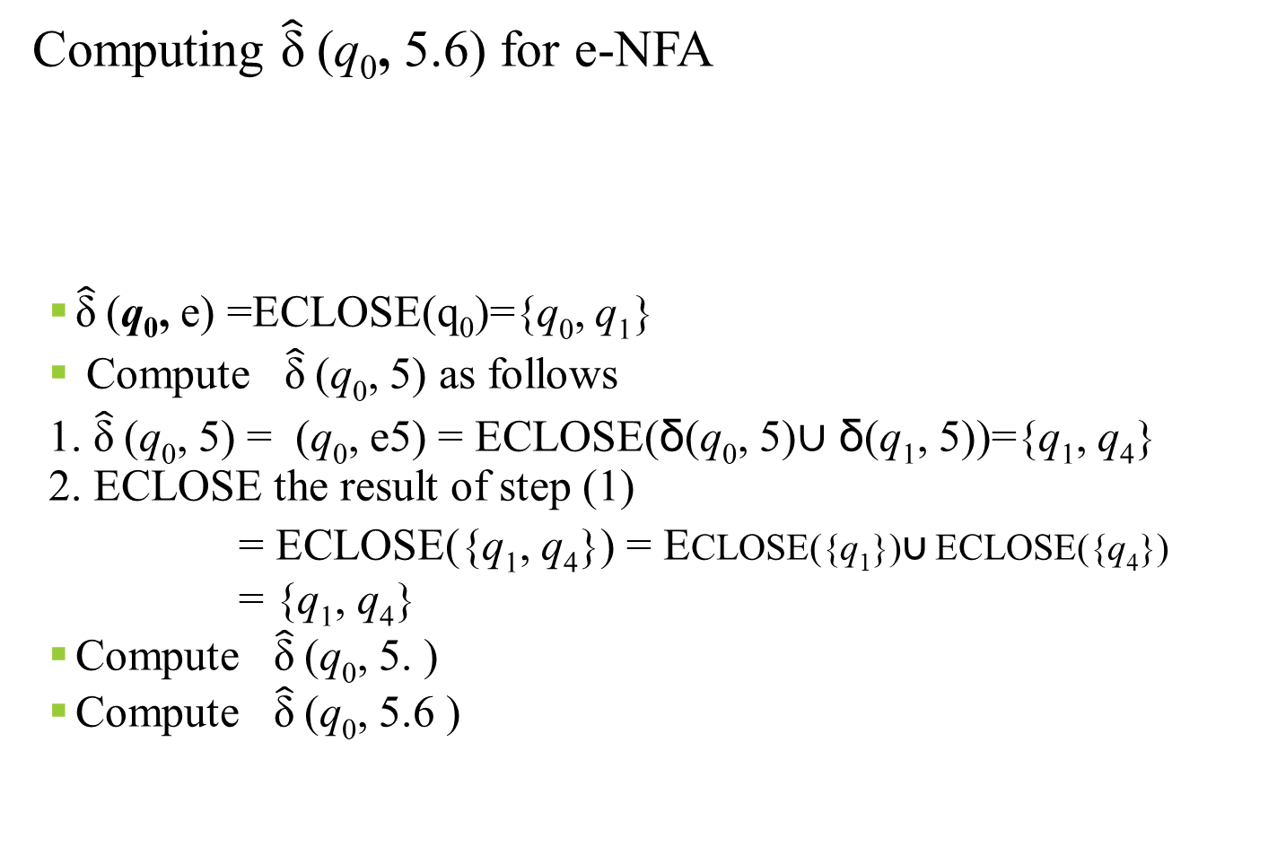
FA with ε-transition
Computing $\hat{\text{δ}}$(q₀, 5.6) for e-NFA
$\hat{\text{δ}}$(q₀,e) =ECLOSE(q₀)={q₀, q₁}
Compute $\hat{\text{δ}}$(q₀, 5) as follows
1. $\hat{\text{δ}}$(q₀, 5) = (q₀, e5) = ECLOSE(δ(q₀, 5)∪ δ(q₁, 5))={q₁, q₄}
2. ECLOSE the result of step (1)
= ECLOSE({q₁, q₄}) = ECLOSE({q₁})∪ ECLOSE({q₄})
= {q₁, q₄}
Compute $\hat{\text{δ}}$(q₀, 5. )
Compute $\hat{\text{δ}}$(q₀, 5.6 )

Slide 20
Eliminating ε-Transitions
Eliminating ε-Transitions
The ε-transition is good for design of FA, but for implementation, they have to be eliminated.
Given an ε-NFA, we can find an equivalent DFA (a theorem seen later).
Let E = (Q_{E}, S, δ_{E}, q₀, F_{E}) be the given ε-NFA, the equivalent DFA
D = (Q_{D}, S, δ_{D}, q_{D}, F_{D}) is constructed

Slide 21
Eliminating ε-Transitions..
Q_{D} is the set of subsets of Q_{E}, in which each accessible is an e-closed subset of Q_{E}, i.e., are sets S ⊆ Q_{E} such that S = ECLOSE(S).
In other words, each e-closed set of states, S, includes those states such that any e-transition out of one of the states in S leads to a state that is also in S.
q_{D} = ECLOSE(q₀) (initial state of D)
F_{D} = {S | S∈Q_{D} and S∩F_{E}≠φ}

Slide 22
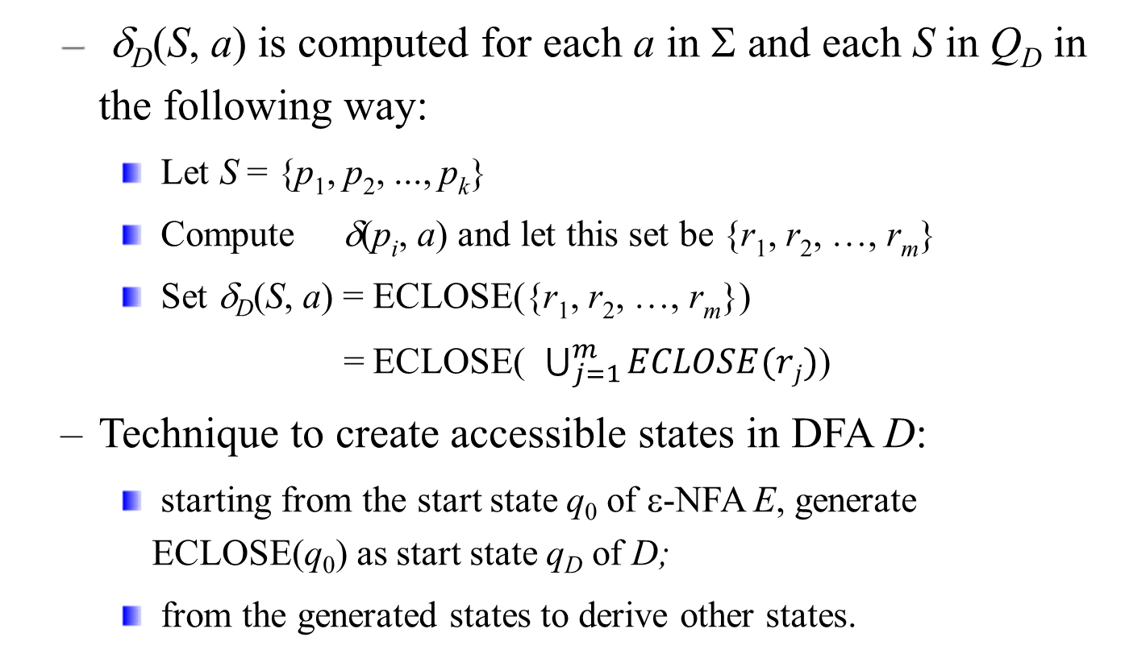
Eliminating ε-Transitions..
δ_{D}(S, a) is computed for each a in Σ and each S in Q_{D} in the following way:
Let S = {p₁, p₂, ..., p_{k}}
Compute δ(p_{i}, a) and let this set be {r₁, r₂, …, r_{m}}
Set δ_{D}(S, a) = ECLOSE({r₁, r₂, …, r_{m}})
= ECLOSE( $\bigcup_{j=1}^{m}{ECLOSE(rj)}$)
Technique to create accessible states in DFA D:
starting from the start state q₀ of ε-NFA E, generate ECLOSE(q₀) as start state q_{D} of D;
from the generated states to derive other states.

Slide 23
Finite Automata with Epsilon-Transitions
Start state q_{D} = ECLOSE(q₀) = {q₀, q₁}
d_{D} ({q₀, q₁}, +) = ECLOSE(d_{E}(q₀, +)∪d_{E}(q₁, +))
= ECLOSE({q₁}∪ φ) = ECLOSE({q₁}) = {q₁}
d_{D}({q₀, q₁}, 0) = ECLOSE(d_{E}(q₀, 0)∪d_{E} (q₁, 0))
= ECLOSE (φ ∪{q₁, q₄}) = ECLOSE({q₁, q₄}) = {q₁, q₄}
d_{D}({q₀, q₁}, .) = ECLOSE(d_{E}(q₀, .)∪ d_{E}(q₁, .)) = {q₂}
0, 1, …, 9
{q₁, q₄}
+ , -
start
{q₀, q₁}
{q₁}
.
{q₂}

Slide 24
Finite Automata with Epsilon-Transitions
δ_{D}({q₁}, 0) = ECLOSE(δ_{E}(q₁, 0)) = ECLOSE({q₁, q₄})
= {q₁, q₄}...
δ_{D}({q₁}, .) = ECLOSE(δ_{E}(q₁, .)) = ECLOSE({q₂})
= {q₂}
0, 1, …, 9
{q₁, q₄}
+ , -
0,1,..,9
start
{q₀, q₁}
{q₁}
.
.
{q₂}

Slide 25
Finite Automata with Epsilon-Transitions
0, 1, …, 9
.
0, 1, …, 9
{q₁, q₄}
{q₂, q₃, q₅}
+ , -
0, 1, …, 9
start
{q₀, q₁}
{q₁}
.
0, 1, …9
.
{q₂}
0, 1, …9
{q₃, q₅}
0, 1, …, 9

Slide 26
Finite Automata with Epsilon-Transitions
The dead state φ need be shown.
0, 1, …, 9
.
0, 1, …, 9
{q₁, q₄}
{q₂, q₃, q₅}
+ , -
0, 1, …, 9
+, -
{q₀, q₁}
{q₁}
+, -, .
start
.
0, 1, …9
+, -
φ
.
+, -, .
+, -, .
{q₂}
all symbols
{q₃, q₅}
0, 1, …, 9
0, 1, …, 9

Slide 27
Finite Automata with Epsilon-Transitions
0, 1, …, 9
.
0, 1, …, 9
{q₁, q₄}
{q₂, q₃, q₅}
+ , -
0, 1, …, 9
+, -, .
start
{q₀, q₁}
{q₁}
.
+, -
φ
0, 1, …9
.
+, -, .
{q₂}
all symbols
{q₃, q₅}
0, 1, …, 9
0, 1, …, 9

Slide 28
Theorem 1
If D = (Q_{D}, Σ, δ_{D}, {q₀}, F_{D}) is the DFA constructed from NFA N = (Q_{N}, Σ, δ_{N}, {q₀}, F_{N}) by the subset construction, then L(D)=L(N).
PROOF: We prove by induction on |w|, is that
δ_{D}({q₀}, w) = δ_{N}(q₀, w)
^
^

Slide 29
BASIS: Let |w| =0; that is, w = ε by the basis definition of δ for DFA’s and NFA’s, both δ_{D}({q₀}, ε) and δ_{N}(q₀, ε) are {q₀}.
INDUCTION: Let w be of length n + 1, and assume the statement for length n. Break w up as w = xa, where a is the final symbol of w. By the induction hypothesis, δ_{D}({q₀}, x) = δ_{N}({q₀}, x). Let both these sets of N’s states be {p₁, p₂,…,p_{k}}.
The inductive part of the definition of δ for NFA’s tell us
δ_{N}(q₀, w) = δ(q₀, xa)
δ_{N}(q₀, x) = {p₁, p₂,…,p_{k}}
δ_{N}(q₀, w) = Uδ_{N}(p_{i}, a) ………(1)
The subset construction, on the other hand, tells us that
δ_{D}({p₁, p₂,…,p_{k}}, a) = Uδ_{N}(p_{i}, a) ……..(2)
Now, let us use (2) and the fact that δ_{D}({q₀}, x) = {p₁, p₂,…,p_{k}} in the inductive part of the definition of δ for DFA’s:
δ_{D}({q₀}, w) = δ_{D}(δ_{D}({q₀}, x), a) = δ_{D}({p₁, p₂,…,p_{k}}, a = Uδ_{N}(p_{i}, a)
Thus the above equations demonstrate that δ_{D}({q₀}, w) = δ_{N}(q₀, w).
When we observe that D and N both accept w if and only if δ_{D}({q₀}, w) or δ_{N}(q₀, w), respectively, contain a state in F_{N}, we have a complete proof that L(D) = L(N).
^
^
^
^
^
^
^
^
^
^
^
^

Slide 30
Design an NFA to recognize the following set of strings
Exercise 2.4.1
a) abc, abd, and aacd. Assume the alphabet is {a, b, c, d}

Slide 31
 | a | b | c | d
->q0 | {q0,q1,q4,q7} | {q0} | {q0} | {q0}
q1 | {} | {q2} | {} | {}
q2 | {} | {} | {q3} | {}
*q3 | {} | {} | {} | {}
q4 | {} | {q5} | {} | {}
q5 | {} | {} | {} | {q6}
*q6 | {} | {} | {} | {}
q7 | {q8} | {} | {} | {}
q8 | {} | {} | {q9} | {}
q9 | {} | {} | {} | {q10}
*q10 | {} | {} | {} | {}

Slide 32
Thank you ☺

